Slide 1
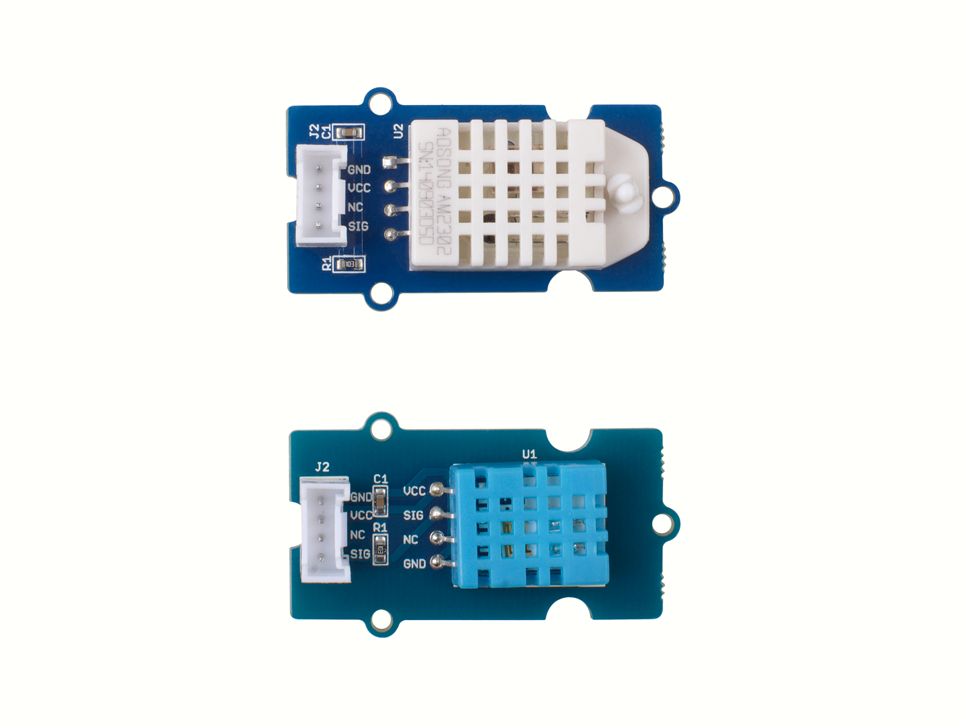
Grove - Temperature&Humidity Sensor Pro (AM2302/DHT22)
Measurement Range:
0 ~ 100%RH
Measurement Range:
-40 ~ 80℃
Accuracy:
Typical ±2%
Accuracy:
Typical ±0.5℃
VS
Temperature
Humidity
Measurement Range:
20 ~ 80%RH
Measurement Range:
0 ~ 50℃
Accuracy:
Typical ±5%
Accuracy:
Typical ±2℃
Grove - Temperature&Humidity Sensor (DHT11)

